Slide 1

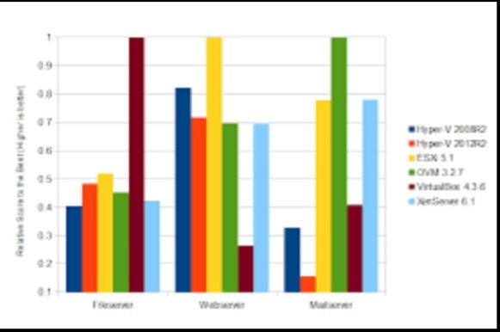
Performance Benchmarking
Of Type 2 Hypervisor
Presented By:
Shahrukh khan
Ananya Agarwal
Nitin Agarwal
Mentor: Mr. Saurabh Singhal Sir
Abhitrapt Gautam
Shivam Singh

Slide 2
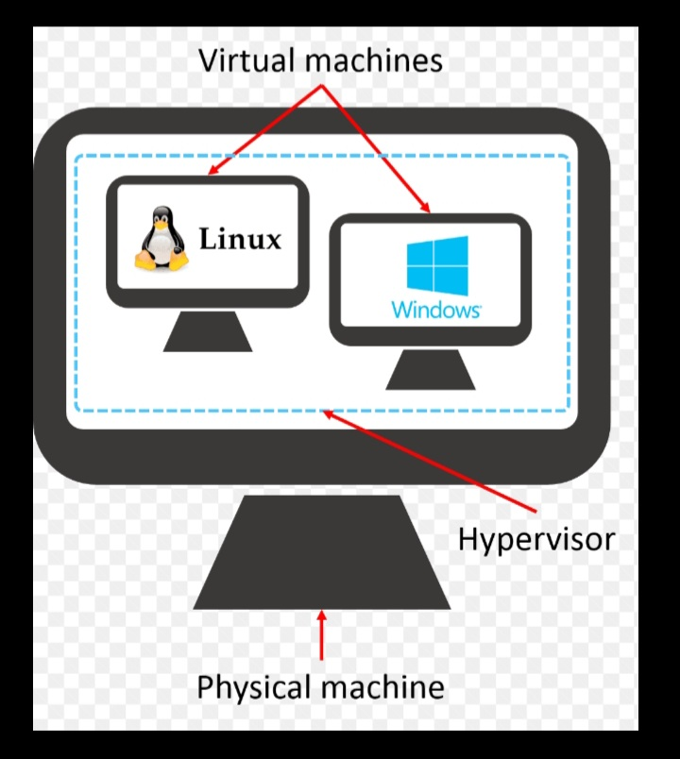
Introduction
The virtualization is carried out by the software layer called as the Hypervisor or Virtual Machine Monitor (VMM). Hypervisor is widely used in cloud datacenters. Benchmark is the measurement of best practice performance. Benchmarking is very essential term for the discovery of the best performance given by the particular system. Benchmarking can provides you the external references and the best practices on which to base your evaluations and to design your system processes which can be very useful in finding the gaps in the system to achieve the desired performance. Your target hypervisors are Virtual Box, VMWare workstation as an hosted hypervisors and KVM. Performance analysis of network, cpu, ram, I/O need to carried out

Slide 3
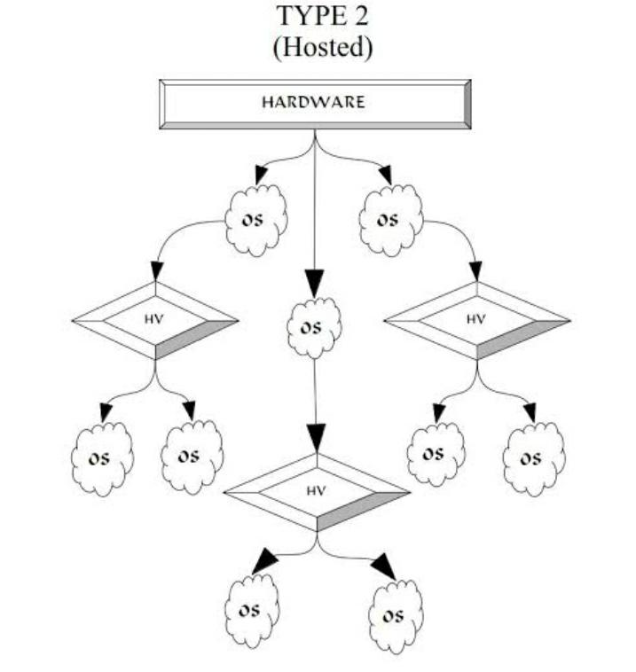
Main Objective
Our main objectives of implementing this project are:
To implement different Virtual Machines(Ubuntu , Fedora etc.)
To examine the performance of different VM’s
To perform the analysis of different VM’s under hosted Hypervisors.
Then we checking the performance of stress and load taken by each VM and then differentiating with the help of graphical representation in terms of network , CPU , RAM etc. on virtualized Environment .
To analyze the performance of different hypervisors with the similar hardware configuration and operating System.

Slide 4
Proposed Methodology
This section briefly describes about the methodology followed, like different types hypervisors and bench marking tools used in this project
Hypervisors -
Virtualization is carried out by the software layer called as the Hypervisor or Virtual Machine Monitor (VMM). There exists various type of hypervisors like open source Hyper-visors and commercial Hypervisors. In the area like Distributed Database, Parallel computing and Cloud computing Hypervisor is widely used2 . Below are the two different hypervisors taken for analysis in this complete project that are:
Virtual Box
VMware

Slide 5
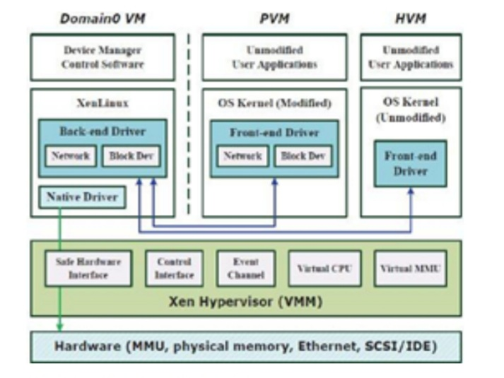
Virtual Box
Virtual Box virtualization is a cross-platform application. It hosted hypervisor type. It installs on your existing Intel or AMD-based computers, whether they run on Windows, Mac, Linux or Solaris operating system. Secondly, it extends the existing capabilities of the computer, so that it can run multiple operating systems at the same time (multi-virtual machine).

Slide 6
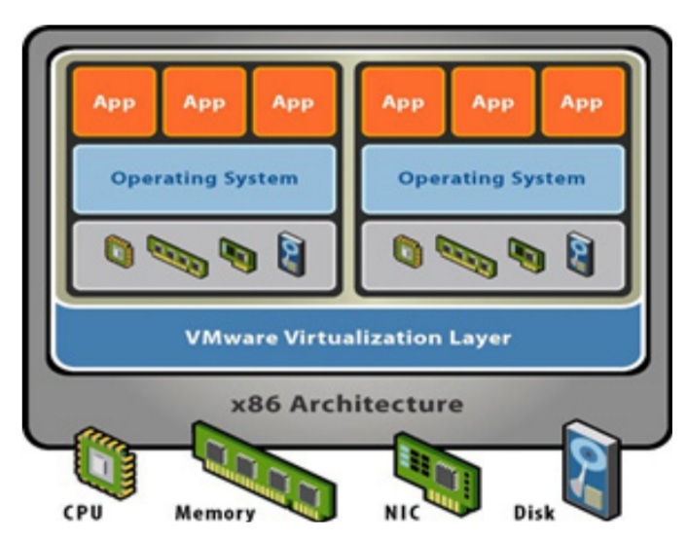
VMware
Here we used the VMware workstation 9.0 as the hosted hypervisor. VMware Workstation, in the Windows and Linux operating systems running a hosted hypervisor (an earlier version of the x86 version available) 64-bit version; it enables the user to build a single physical machine Virtual Machine (VM), and use them at the same time along with the actual machine.

Slide 7
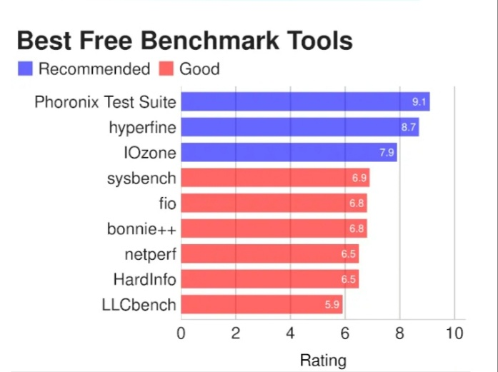
Benchmarking Tools Used to perform the analysis
There are different tools available to benchmark and as well to generate the stress to operating system. But we basically used two common tools such as : -
Stress
Glances

Slide 8


Stress Tool
Stress is an open source software in Linux which is used to create the stress on OS and this will help in analyzing the performance. Stress is a deliberately simple workload generator for POSIX systems. It imposes a configurable amount of CPU , memory , I/O, and disk stress on the system.

Slide 9


Glances Tool
Glances is a cross-platform monitoring tool which aims to present a maximum of information in a minimum of space through a curses or Web based interface. It can adapt dynamically the displayed information depending on the terminal size. In simple it is a monitoring tool
Thus it is free software to monitor Linux Operating System from a text interface.

Slide 10
Glance color codes:-
Meaning of Glances color code:
1. GREEN : OK (everything is fine)
2. BLUE : CAREFUL (need attention)
3. VIOLET : WARNING (alert)
4. RED : CRITICAL (critical)
We can set thresholds in configuration file.
By default thresholds set is (careful=50, warning=70 and critical=90),
we can customized as per our needs.
The default configuration file is located at ‘/etc/glances/glances.conf’.

Slide 11
Factors Considered for Benchmark
The Factors considered for benchmarking the performance of Type 2 Hypervisors are:
CPU Usage - CPU performance measurement is very important for large scale infrastructure like cloud data canters. In Large scale systems CPU Computing power is allocated/ shared in between to run multi tenant environments. It includes the percentage of CPU used for carried out the task given by the stress.
Memory Usage-

Slide 12
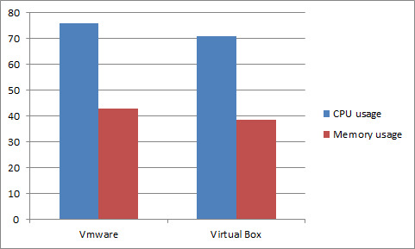
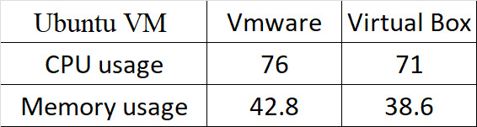
Result Obtained
There is the result obtained on performing the benchmarking on two different hypervisors that is VMware and Virtual Box of two VM’s that is :
For Ubuntu VM-

Slide 13
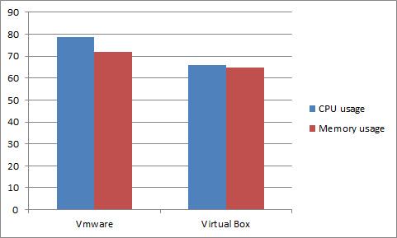
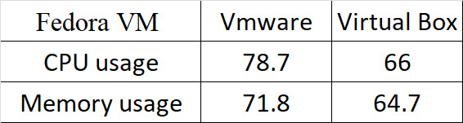
For Fedora VM-

Slide 14

Conclusion
At last we conclude by focusing on study of Virtualization, Hypervisor and Benchmarking. We have carried out experiment to benchmark different hypervisor performance with respect to CPU usage and memory usage. From the experiment carried out we may conclude that Best CPU performance is given by VMware Of Fedora VM that is 78.7. While Best memory usage performance is given by Virtual Box of Ubuntu VM. The Performance of hypervisor may vary for different perspectives. The performance of different hypervisors may get influenced by the environment and the resources.

Slide 15


